Slide 1
STAT3008/7001 Applied Statistics
Tutorial 1
Ziren Chen
u4975835@anu.edu.au

Slide 2
Consultation
Thursday 10am-11am
CBE 3.09
Appointment by email

Slide 3
This Course
Learning from doing course
R code in tutorial
R code in assignment (learn coding)
Final exam (learn interpreting)
Useful in future career

Slide 4
This tutorial
Ice breaking/introduce yourself
Introduce R/Rstudio
preview/review
Let’s do it together

Slide 5
General information for R
Choosing your working directory. You can use either a USB drive or your ANU disk which is H: drive.
It would be a good idea to save all R scripts, plots and other related documents in your working directory (not on the desk- top!).
Always remember to save your work. Very complex functions and parallel computations could cause R to crash!

Slide 6
General information for R
# will be igored by R
Value of objects is assigned by <-
Command not finish – “+” sign
Error message – debug

Slide 7
Example Problem:
Data
Yellowness of Tail Feathers of the Northern Flicker Birds
”Odd” feathers are presumed to be regrown feathers after being lost
In the population of all northern flicker birds, is there sufficient evidence to say that ”odd” feathers are significantly different from the ”typical” feathers in terms of yellowness?
In the population of all northern flicker birds, how odd are the odd feathers compared to typical feathers in terms of yellowness?
Bird | Typical | Odd
A | -0.255 | -0.324
B | -0.213 | -0.185
C | -0.19 | -0.299
D | -0.185 | -0.144
E | -0.045 | -0.027
F | -0.025 | -0.039
G | -0.015 | -0.264
H | 0.003 | -0.077
I | 0.015 | -0.017
J | 0.02 | -0.169
K | 0.023 | -0.096
L | 0.04 | -0.33
M | 0.04 | -0.346
N | 0.05 | -0.191
O | 0.055 | -0.128
P | 0.058 | -0.182

Slide 8
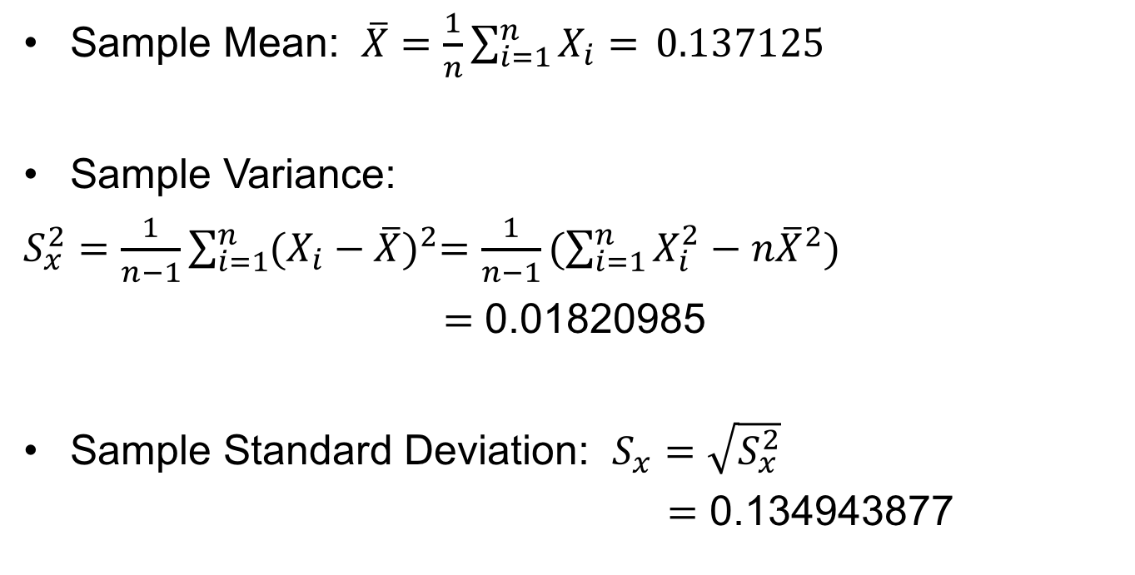
Some revision: Introductory Statistics

Slide 9
Introductory Statistics
From the sample mean, it can be said that the typical feathers are on the average 0.137125 units more yellow than odd feathers.
From the sample standard deviation, it can be said that the difference in yellowness between typical and odd feathers might fluctuate on average by about 0.1349 units above or below the stated average difference of 0.137125 units

Slide 10
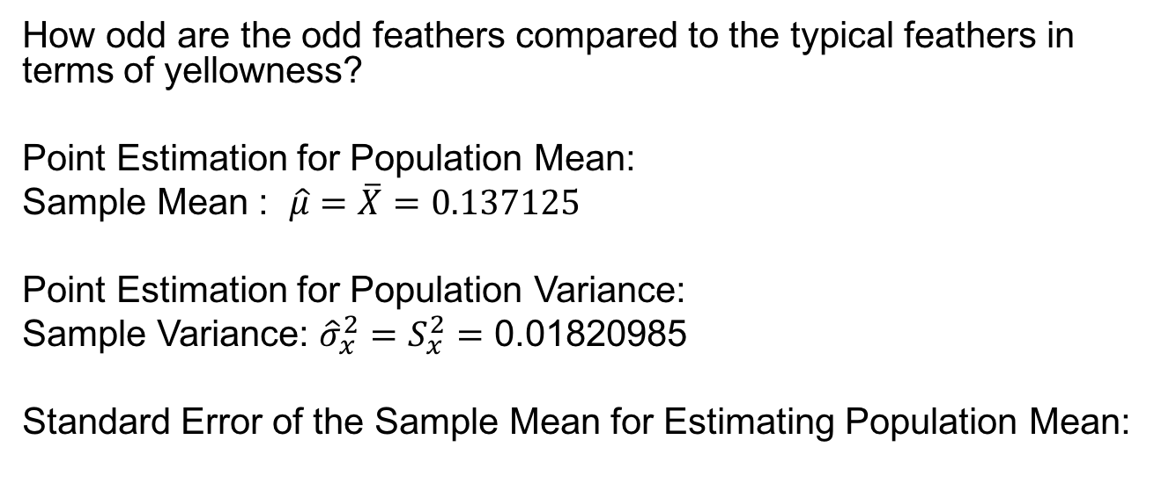
Inferences from data

Slide 11
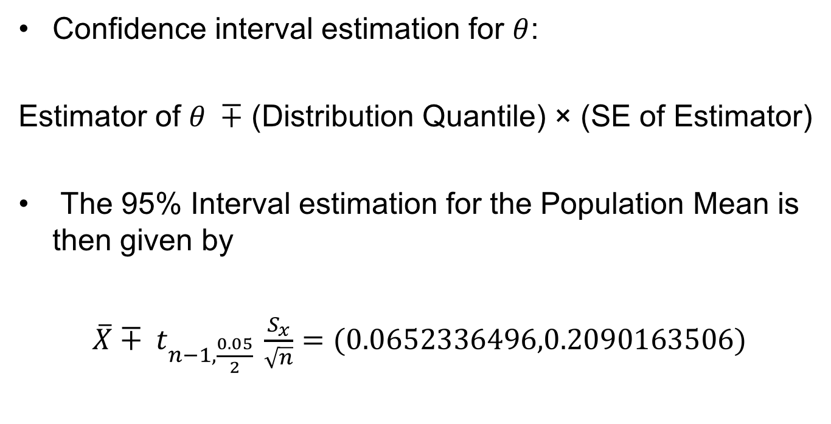
Inferences from data

Slide 12
Inferences from data
We are 95% confident that the true population mean difference of yellowness between typical and odd feathers is between 0.0652 units and 0.2090 units. Since zero is not inside the interval, there is evidence to support that the typical feathers are different from odd feathers in terms of yellowness. The typical feathers tend to be more yellow than odd feathers.

Slide 13
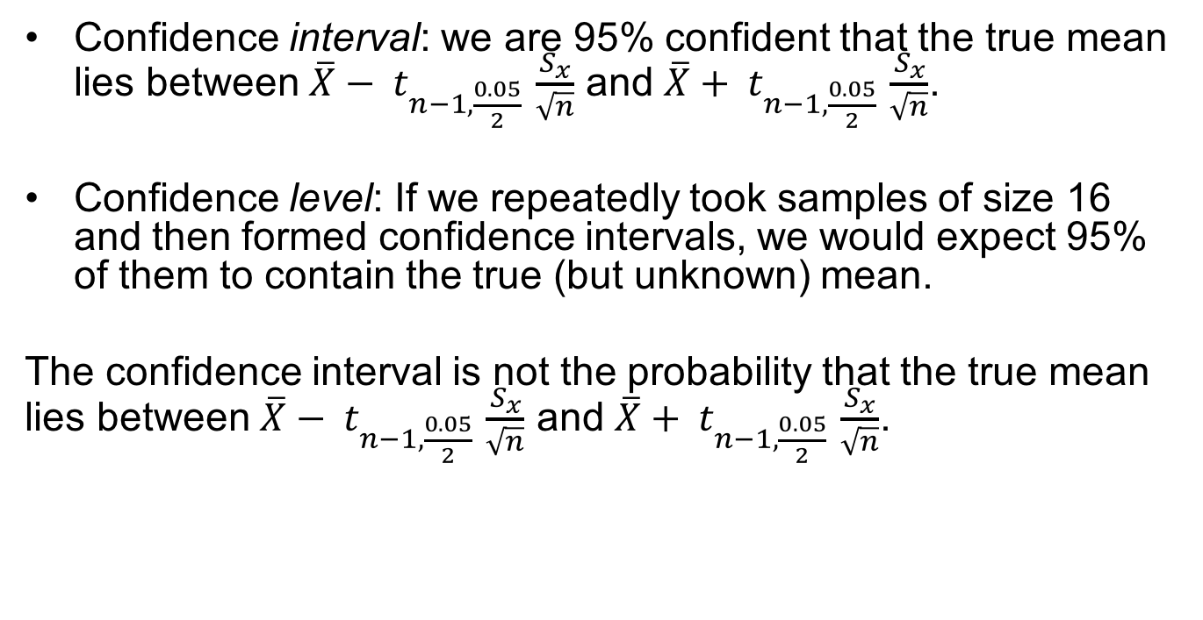
Confidence intervals and confidence levels

Slide 14
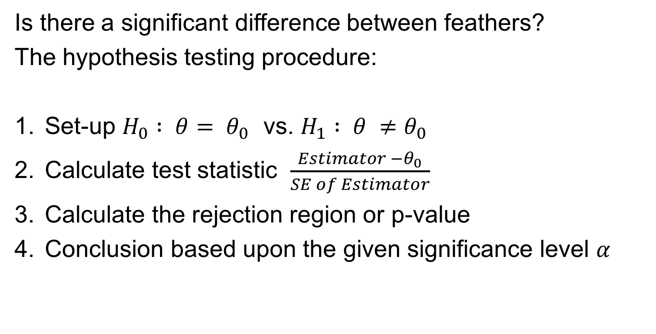
Inferences from data

Slide 15
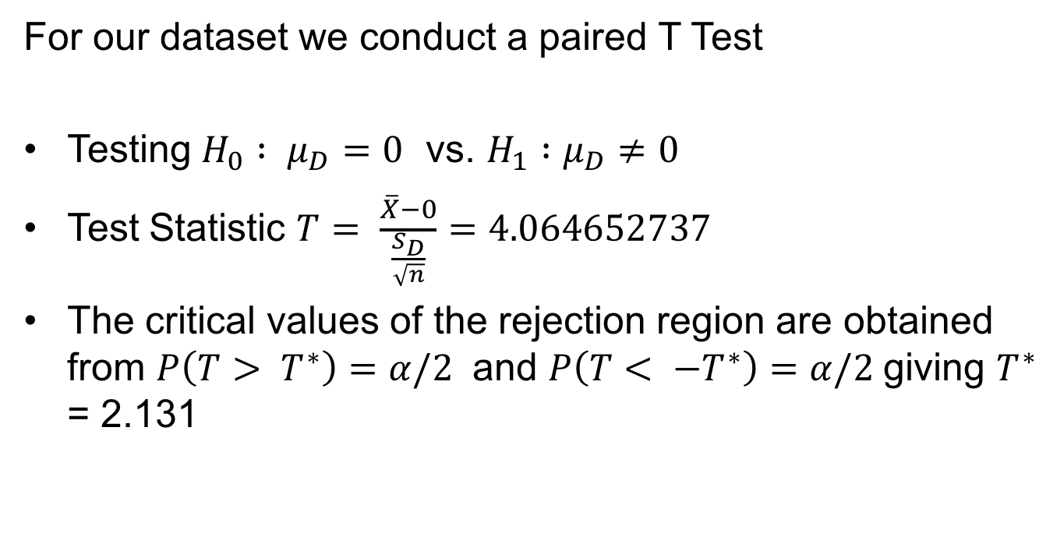
Inferences from data

Slide 16
Inferences from data
Since 4.0647 > 2.131, we reject H0. There is sufficient evidence to conclude that there is a difference in yellowness between typical and odd feathers for the population of northern flicker birds.

Slide 17
Introductory R
This course will use R for all numerical work
Recommended book: The Undergraduate Guide to R

